Slide 1
MULTICLASS CLASSIFICATION PROJECT

Slide 2
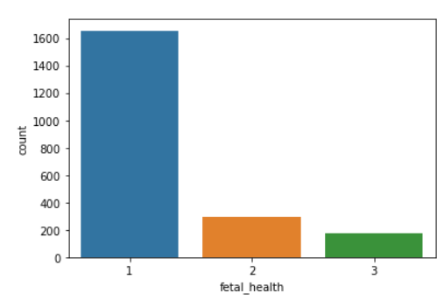
INTRODUCTION
PROJECT ON FETAL HEALTH STATUS
In this project, I have built various model of the ‘Fetal Health Classification’ dataset which contains various information of the fetus. Fetal mortality is a public health issue that put in risk the women’s or baby’s life. This project uses several Machine Learning Classification techniques in order to predict the risk level of the fetal health ,it attempts to classify that into three classes namely-
Normal
Suspect
Pathological
Cardiotocography (CTG) is used during pregnancy to monitor fetal
heart rate and uterine contractions. It is monitor fetal well-being
and allows early detection of fetal distress. CTG interpretation helps
in determining if the pregnancy is high or low risk.
In this project, I created models to classify the outcome of
Cardiotocogram test to ensure the well being of the fetus.

Slide 3
Study Framework of X and Y variable
INDEPENDENT VARIABLES
DEPENDENT VARIABLE
BASELINE VALUE
ACCELERATIONS
PREDICTOR
FETAL_HEALTH
FETAL
MOVEMENT
UTERINE
CONTRACTIONS
DECELERATIONS
HEART BEAT VALUES

Slide 4
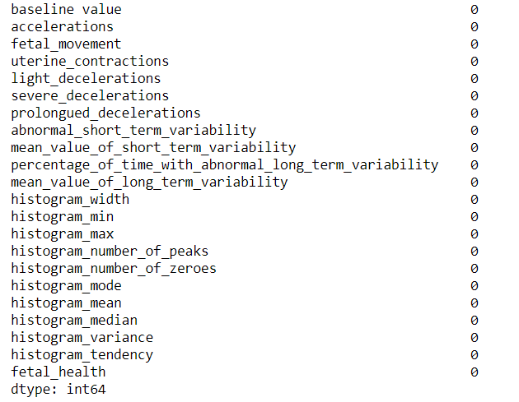
HANDLING MISSING VALUES
Handling missing values is an important part of the EDA process. The variables which are having very few missing values as compared to the size of the dataset, we may choose to drop the rows that have missing values or impute the missing values based on the non-missing values with some value.
In this dataset, there is no missing values.

Slide 5
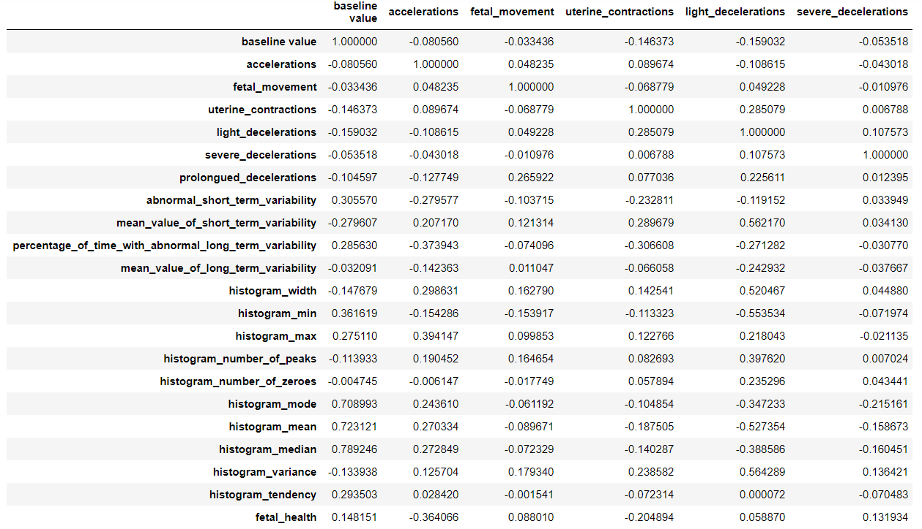
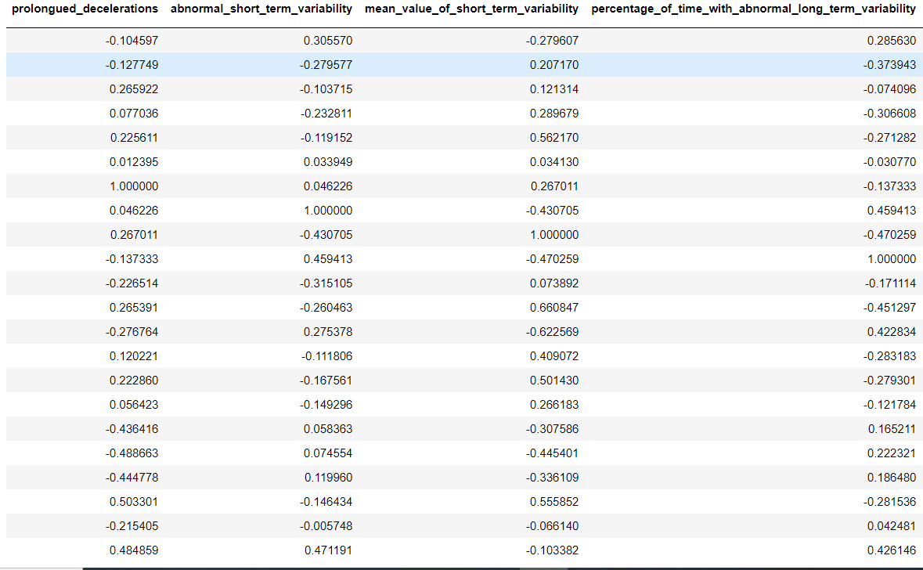
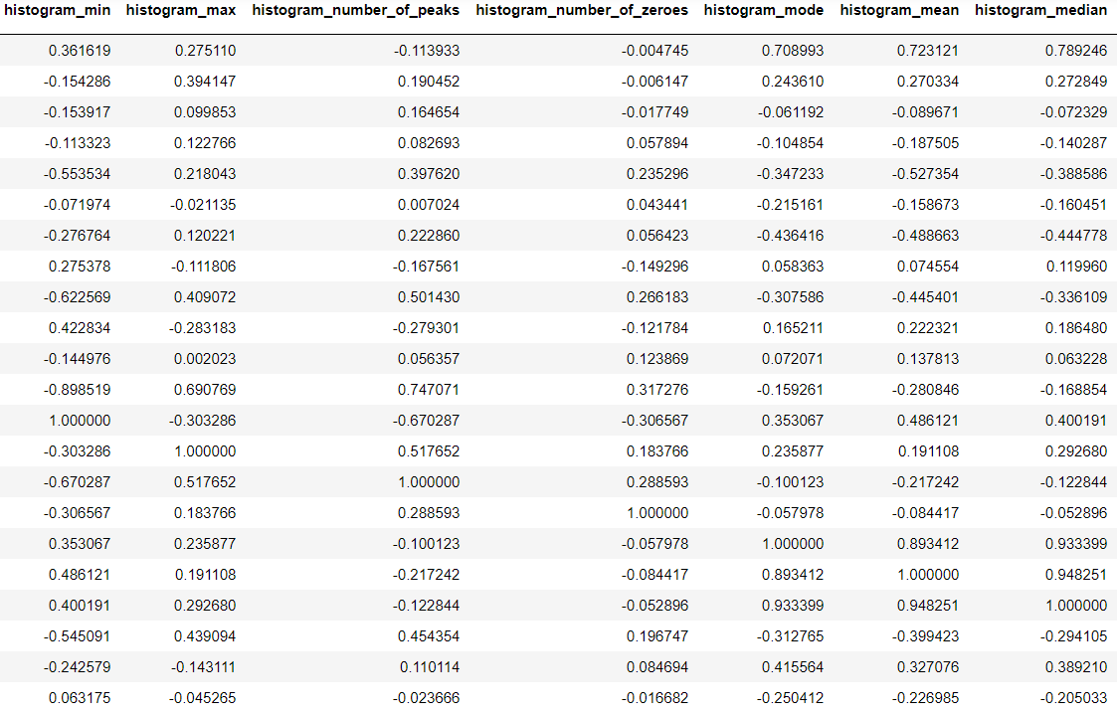
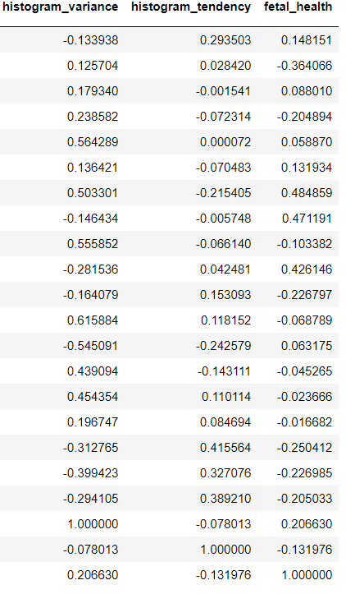
CORRELATION
Correlation quantifies the direction and strength of the relationship between two numeric variables, X and Y. Here, I found a strong positive relationship between fetal_health(Y) and decelerations(X) followed by abnormal long term variability(X) and baseline value(X).

Slide 6
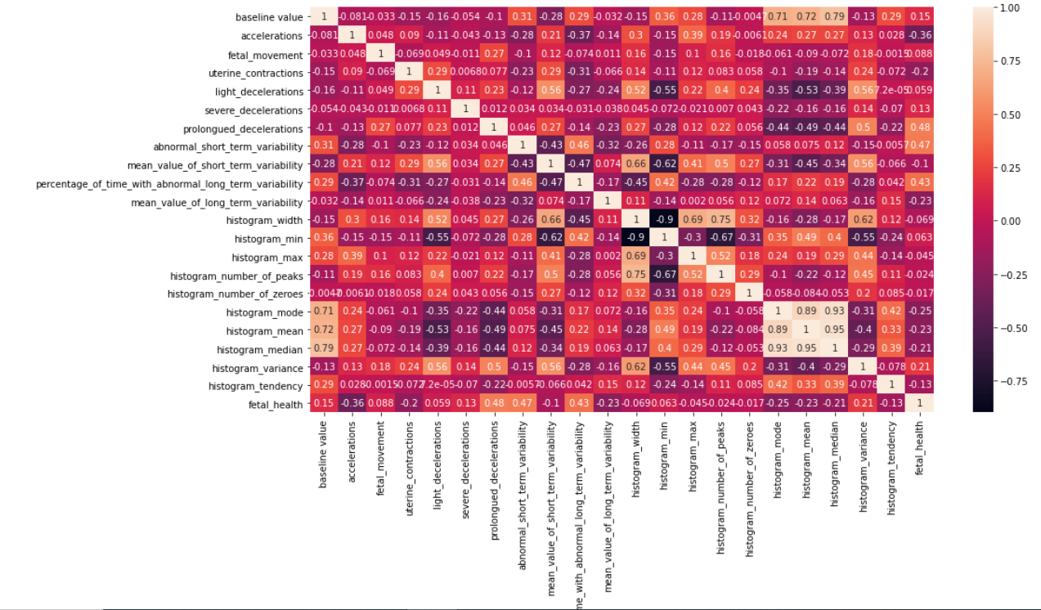
HEATMAP

Slide 7
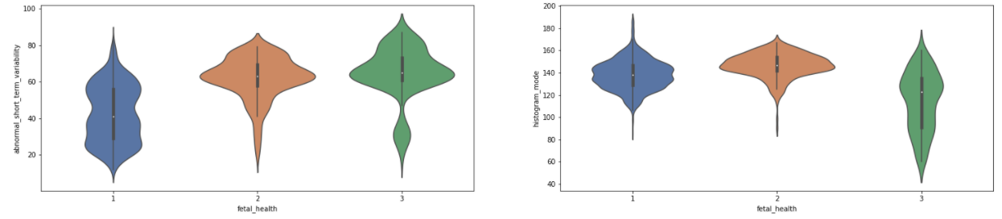
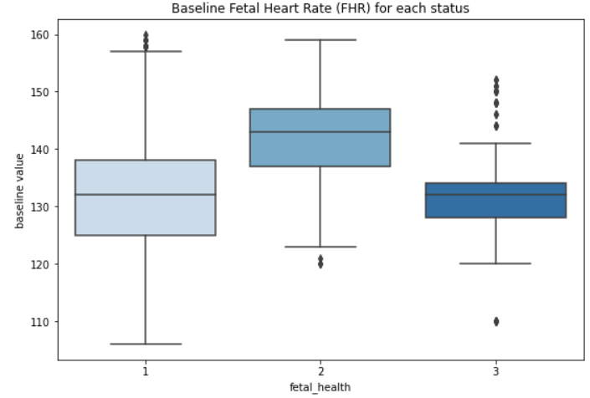
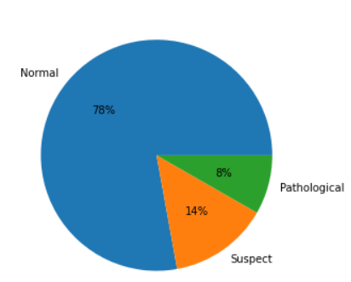
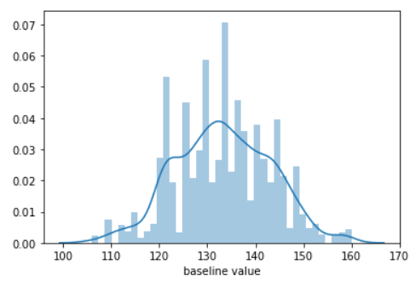
VISUALIZATION

Slide 8
MODEL BUILDING
There are many models for machine learning, and each model has its own strengths and weaknesses. In this project, I have tried various classification algorithms and tuned the parameters using the GridSearchCV which tries all the combinations of the values passed in the dictionary and evaluates the model for each combination using the Cross-Validation method. Hence after using this function we get accuracy/loss for every combination of hyperparameters and we can choose the one with the best performance.
The classifiers I used to find the best model out of them are:-
Logistic Regression
K-Nearest Neighbors(KNN) Classifier
Support Vector Machine(SVM)
Decision Tree Classifier
Random Forest Classifier
AdaBoost Classifier

Slide 9
LOGISTIC REGRESSION MODEL
Logistic Regression is a Machine Learning classification algorithm that is used to predict the probability of a categorical dependent variable.
SCORES FOR THE LOGISTIC REGRESSION MODEL
K-Fold Score | 0.8471505109085887
Best Parameters | 'C': 1, 'max_iter': 1000, 'penalty': 'l1', 'solver': 'saga', 'tol': 0.001
Best Score | 0.8929411764705882
Test Score | 0.9061032863849765

Slide 10
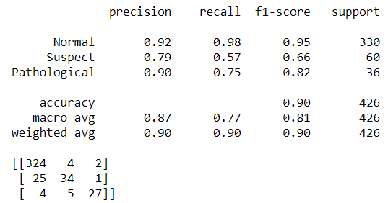
CLASSIFICATION REPORT AND CONFUSION MATRIX
The precision column shows that the predictions for ‘’ Normal” and ‘Pathological’ are somehow good in accuracy.
The recall column shows that the positive cases for ‘Normal’ are caught correctly.
The f1-score column shows that the positive predictions for ‘Normal’ is near to accurate.
The result of Confusion Matrix is telling us that we have 324+34+27 correct predictions and 25+4+4+5+1+2 incorrect predictions.

Slide 11
K-NEAREST NEIGHBORS(KNN)
K-Nearest Neighbors operates by checking the distance from some test example to the known values of some training example. The group of data points/class that would give the smallest distance between the training points and the testing point is the class that is selected.
SCORES FOR THE K-NEAREST NEIGHBORS (KNN) MODEL
K-Fold Score | 0.8250207125103562
Best Parameters | 'algorithm': 'auto', 'leaf_size': 10, 'metric': 'manhattan', 'n_neighbors': 5, 'weights': 'distance'
Best Score | 0.9188235294117648
Test Score | 0.931924882629108

Slide 12
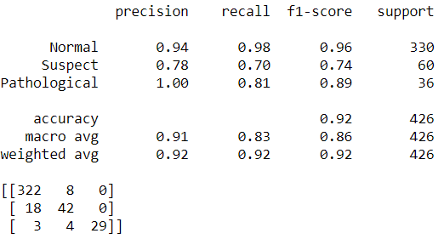
CLASSIFICATION REPORT AND CONFUSION MATRIX
The precision column shows that the predictions for ‘’ Normal” and ‘Pathological’ are somehow good in accuracy.
The recall column shows that the positive cases for ‘Normal’ are caught correctly.
The f1-score column shows that the positive predictions for ‘Normal’ is near to accurate.
The result of Confusion Matrix is telling us that we have 322+42+29 correct predictions and 18+3+4+8 incorrect predictions.

Slide 13
SUPPORT VECTOR MACHINE(SVM)
Support Vector Machines work by drawing a line between the different clusters of data points to group them into classes. Points on one side of the line will be one class and points on the other side belong to another class. The classifier will try to maximize the distance between the line it draws and the points on either side of it, to increase its confidence in which points belong to which class.
SCORES FOR THE SUPPORT VECTOR MACHINE(SVM) MODEL
K-Fold Score | 0.8433736536868268
Best Parameters | 'C': 10, 'degree': 3, 'gamma': 1, 'kernel': 'poly'
Best Score | 0.9123529411764706
Test Score | 0.92018779342723

Slide 14
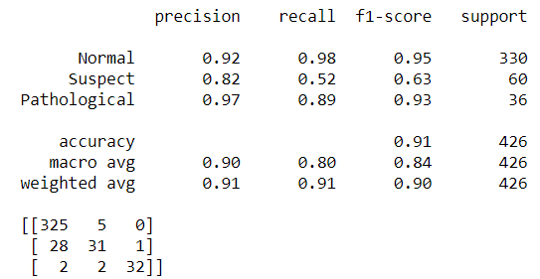
CLASSIFICATION REPORT AND CONFUSION MATRIX
The precision column shows that the predictions for ‘’ Normal” and ‘Pathological’ are somehow good in accuracy.
The recall column shows that the positive cases for ‘Normal’ are caught correctly somehow.
The f1-score column shows that the positive predictions for ‘Normal’ is near to accurate.
The result of Confusion Matrix is telling us that we have 325+31+32 correct predictions and 28+2+2+5+1 incorrect predictions.

Slide 15
DECISION TREE CLASSIFIER
A Decision Tree Classifier functions by breaking down a dataset into smaller and smaller subsets based on different criteria. Different sorting criteria will be used to divide the dataset, with the number of examples getting smaller with every division.
SCORES FOR THE DECISION TREE CLASSIFIER MODEL
K-Fold Score | 0.8226688760011047
Best Parameters | 'criterion': 'entropy', 'max_features': 'log2', 'splitter': 'best'
Best Score | 0.908235294117647
Test Score | 0.9061032863849765

Slide 16
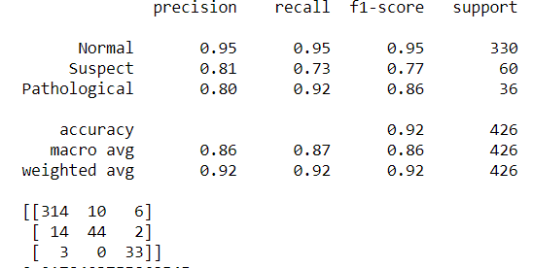
CLASSIFICATION REPORT AND CONFUSION MATRIX
The precision column shows that the predictions for ‘’ Normal” are somehow good in accuracy.
The recall column shows that the positive cases for ‘Normal’ and ‘Pathological ’are somehow caught correctly.
The f1-score column shows that the positive predictions for ‘Normal’ is near to accurate.
The result of Confusion Matrix is telling us that we have 314+44+33 correct predictions and 14+3+10+6+2 incorrect predictions.

Slide 17
RANDOM FOREST CLASSIFIER
The Random Forest Classifier is a set of decision trees from randomly selected subset of training set. It aggregates the votes from different decision trees to decide the final class of the test object.
SCORES FOR THE RANDOM FOREST CLASSIFIER MODEL
K-Fold Score | 0.8659420049710025
Best Parameters | 'criterion': 'entropy', 'max_depth': 8, 'max_features': 'auto', 'n_estimators': 80
Best Score | 0.9364705882352942
Test Score | 0.9483568075117371

Slide 18
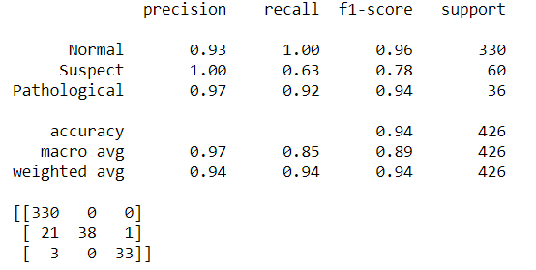
CLASSIFICATION REPORT AND CONFUSION MATRIX
The precision column shows that the predictions for ‘’ Suspect” and ‘Pathological’ are somehow good in accuracy.
The recall column shows that the positive cases for ‘Normal’ and ‘Pathological ’are somehow caught correctly.
The f1-score column shows that the positive predictions for ‘Normal’ and ‘Pathological’ is near to accurate.
The result of Confusion Matrix is telling us that we have 330+38+33 correct predictions and 21+3+1 incorrect predictions.

Slide 19
ADABOOST MODEL
AdaBoost classifier builds a strong classifier by combining multiple poorly performing classifiers so that you will get high accuracy strong classifier. The basic concept behind AdaBoost is to set the weights of classifiers and training the data sample in each iteration such that it ensures the accurate predictions of unusual observations.
SCORES FOR THE ADABOOST MODEL
K-Fold Score | 0.8382060204363435
Best Parameters | 'base_estimator': DecisionTreeClassifier(max_depth=10), 'n_estimators': 100
Best Score | 0.9417647058823531
Test Score | 0.9577464788732394

Slide 20
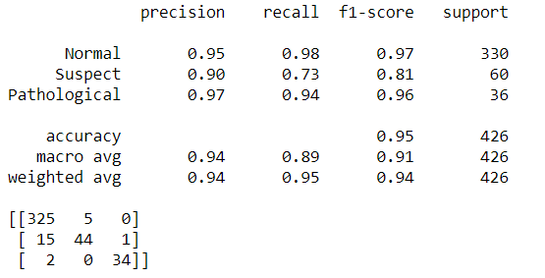
CLASSIFICATION REPORT AND CONFUSION MATRIX
The precision column shows that the predictions for ‘’ Suspect” and ‘Normal’ are somehow good in accuracy.
The recall column shows that the positive cases for ‘Normal’ and ‘Pathological ’are somehow caught correctly.
The f1-score column shows that the positive predictions for ‘Normal’ and ‘Pathological’ is near to accurate.
The result of Confusion Matrix is telling us that we have 325+44+34 correct predictions and 15+2+1+5 incorrect predictions.

Slide 21
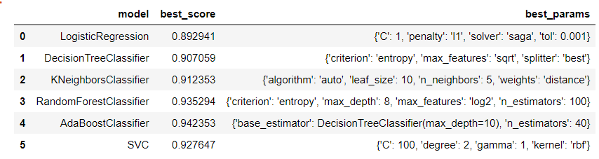
COMPARISON OF MODELS
Out of all the six models built, the best scores came out from the AdaBoost Classifier model and the Random Forest Classifier with the best parameters listed above. Their test scores are also close to the best scores.

Slide 22
COMPARISON OF MODELS
MODEL | TEST SCORES | TRAINING SCORES | K FOLD SCORES | ACCURACY
Logistic Regression | 0.906103286384 | 0.8976470588235295 | 0.851851974592 | 90%
Decision Tree Classifier | 0.903755868544 | 0.9988235294117647 | 0.838658933996 | 92%
K-Neighbors Classifier | 0.931924882629 | 0.9988235294117647 | 0.825020712510 | 92%
Random Forest Classifier | 0.948356807511 | 0.9841176470588235 | 0.871583540458 | 94%
AdaBoost Classifier | 0.950704225352 | 0.9988235294117647 | 0.838206020436 | 95%
Support Vector Classifier | 0.941314553990 | 0.9570588235294117 | 0.8433736536868 | 91%

Slide 23
FINAL CONCLUSION
After comparing all the six models, I came to this conclusion which will help to choose the best model out of all the models to get the best results.
Out of all the models, Random Forest Classifier and the AdaBoost Classifier showed the best scores.
Test scores for all the models are near to the Best Scores.
K-Fold Cross Validation scores are a bit higher in Random Forest Classifier Model.
It seems to be that AdaBoost Classifier with 95% accuracy and the Random Forest Classifier with 94% accuracy are the best performing models.
As per the Classification Report, maximum predictions were caught correctly in Random Forest Classifier and the AdaBoost Classifier.
The test and the training scores for the Logistic Regression and the Support Vector Classifier are near to each other resulting them as the best fit models whereas others showed some sort of overfitting.
So, as per other scores Random Forest Classifier and the AdaBoost Classifier are the best performing models but the best fit models are the Logistic Regression and the Support Vector Classifier model.

Slide 24
THANK YOU !!!

